Slide 1
Blazor + Bot Framework = a Microsoft Teams Platform Dream Team
Stephan Bisser – Solvion
Thomas Gölles – Solvion
Waldek Mastykarz - Microsoft
Notes:
Let’s talk about what’s possible on Microsoft 365

Slide 2

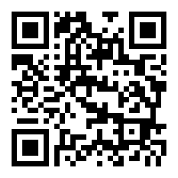
Code of Conduct
As event and experience organizers, we seek to provide a respectful, friendly, professional experience for everyone, regardless of gender, sexual orientation, physical appearance, disability, age, race or religion.
We do not tolerate any behavior that is degrading to any gender, race, sexual orientation, or disability, or any behavior that would be deemed harassment or discrimination.
Individuals are responsible for knowing and abiding by our standards and we encourage everyone to assist in creating a welcoming and safe environment. Please report any concerns, suspicious or disruptive activity or behavior to the organizing team, so that we can address the issue immediately.
More information can be found on the CollabDays Belgium & Netherlands website at https://www.collabdays.org/2021-benl/about

Slide 3
























Our Platinum Sponsors
Community Sponsor
Our Gold Sponsors

Slide 5
Imagine…

Slide 6

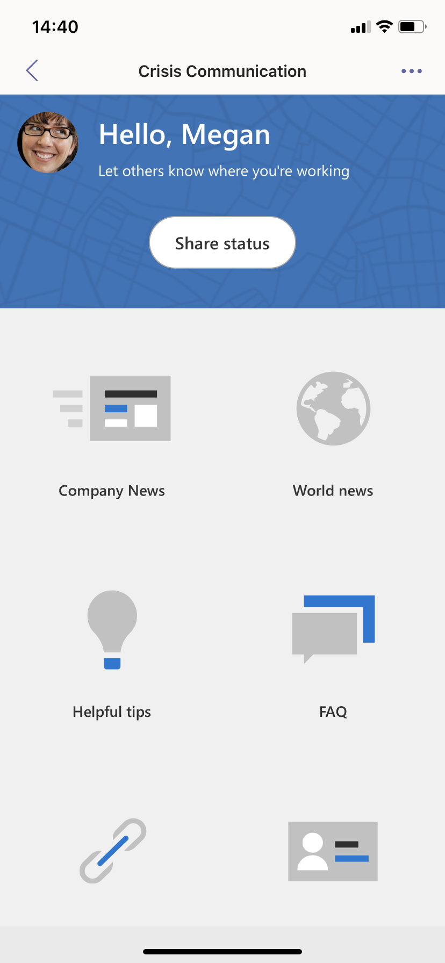
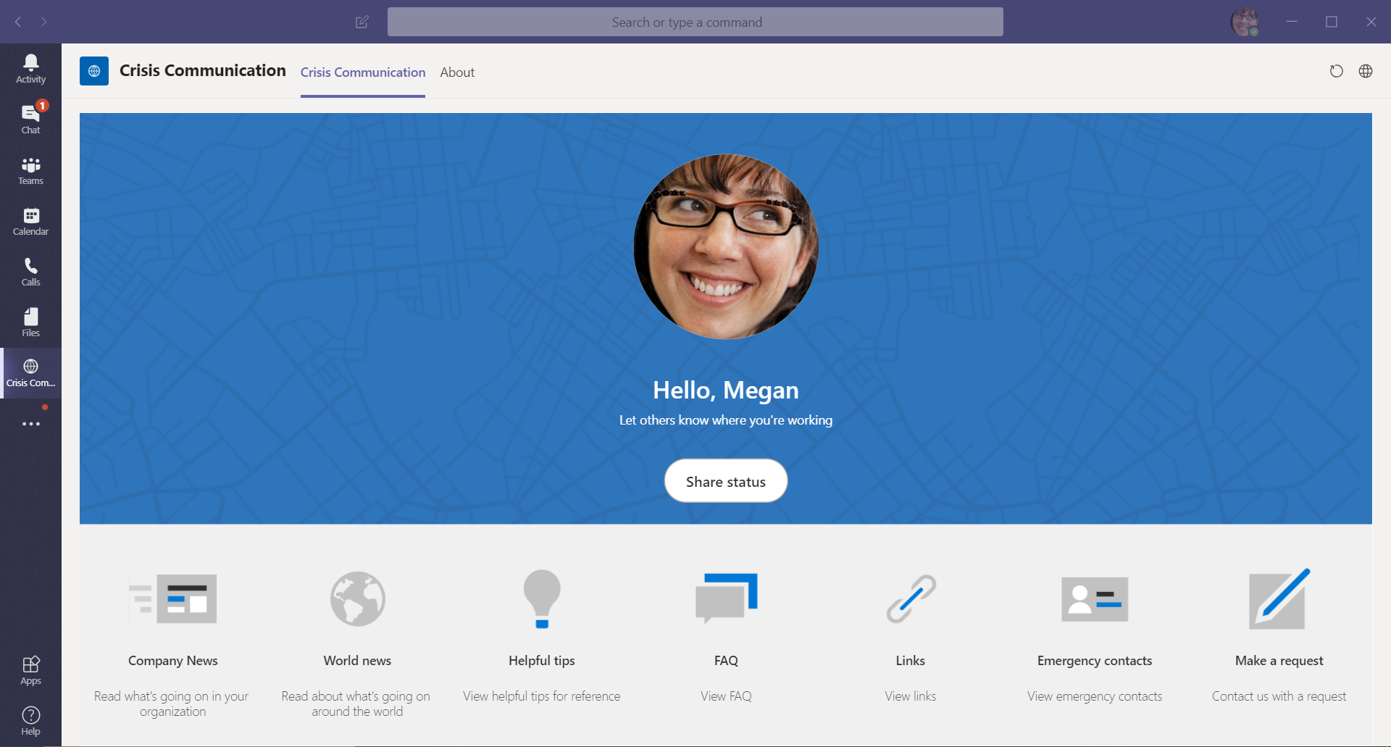
Communicate effectively
Notes:
Get important information from your organization no matter if you are behind your desk or on the go

Slide 7
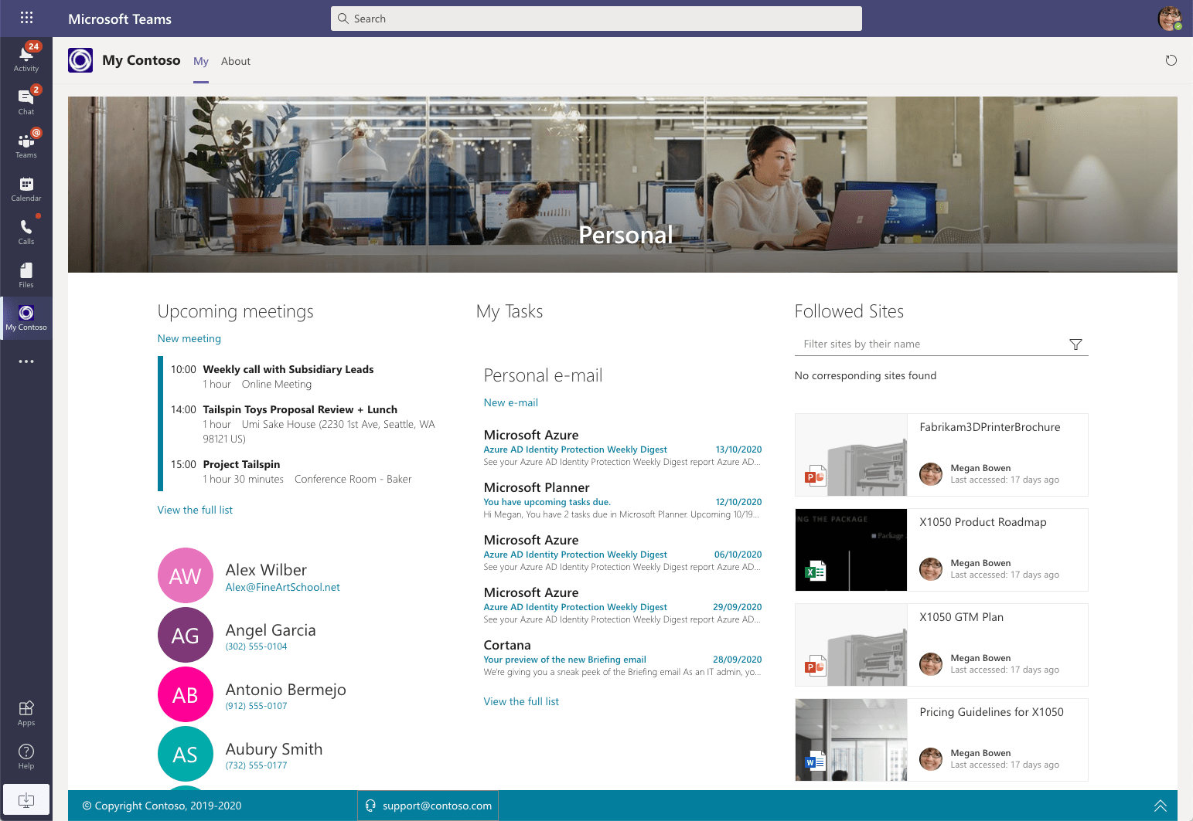
Stay in
the know
Notes:
Stay in the know with what’s happening and what’s going to happen around you and your team

Slide 8
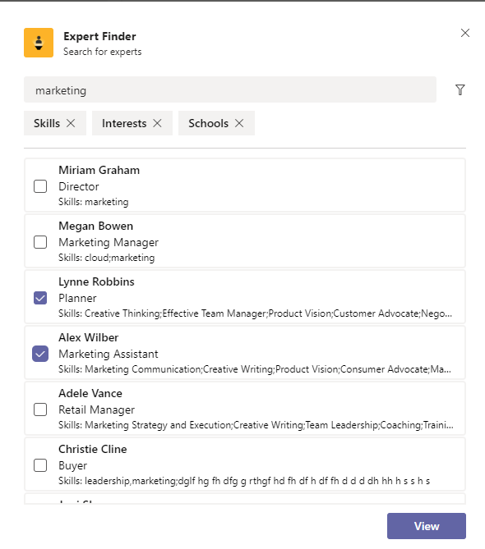
Find experts
Notes:
Find experts in your organization no matter if you know them personally or not

Slide 9
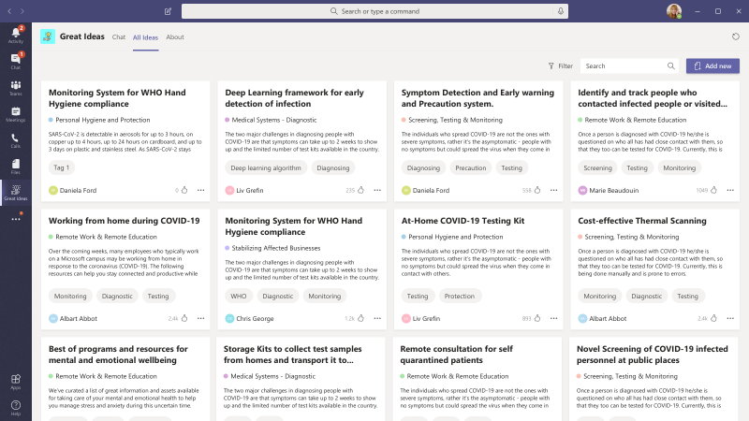
Share
ideas
Notes:
Share ideas and get feedback from others in your organization

Slide 10
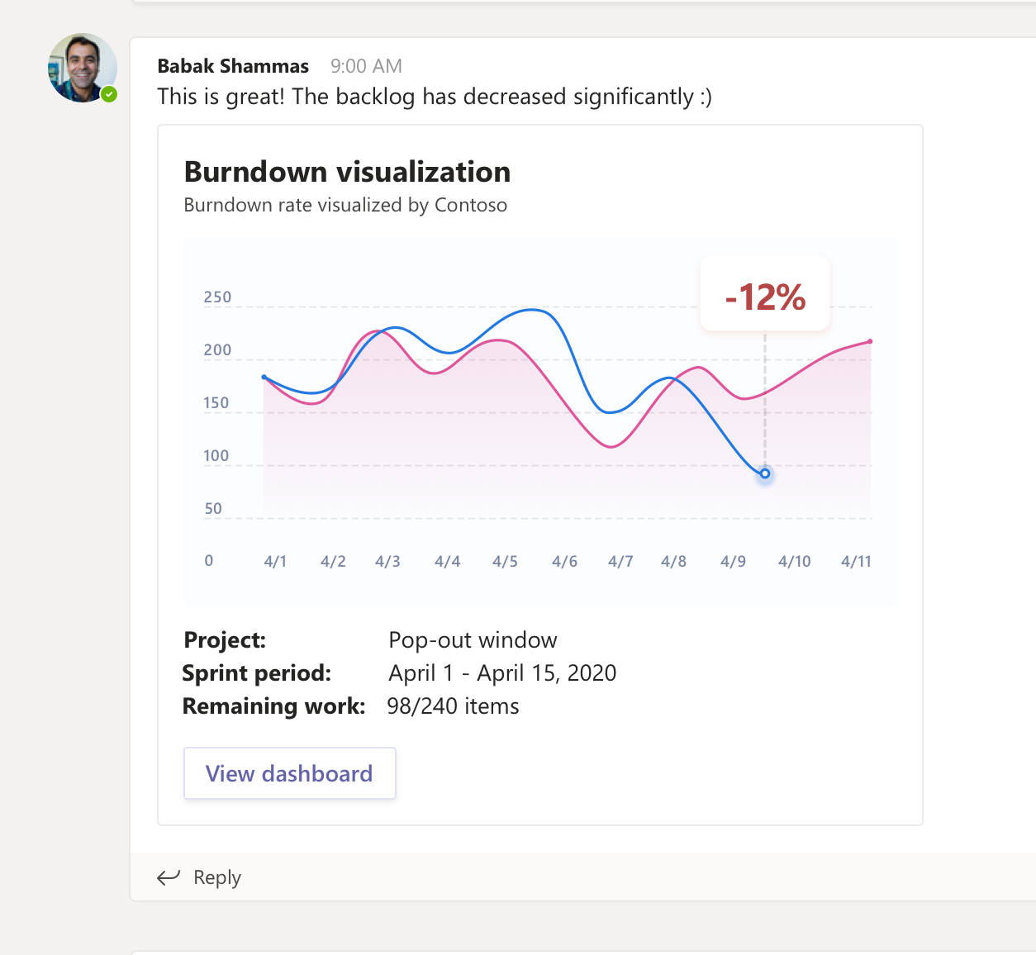
Track progress
Notes:
Track progress of your work in the context of your work

Slide 11
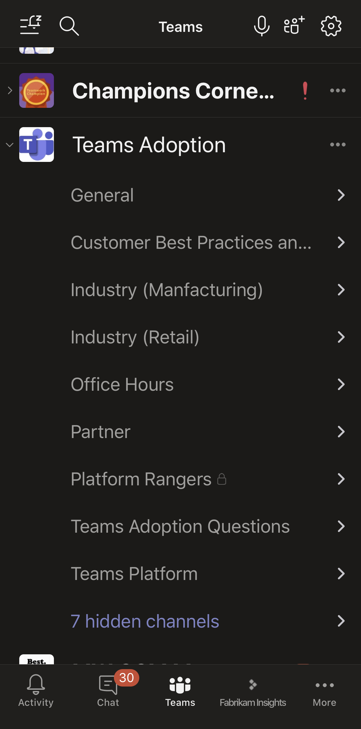
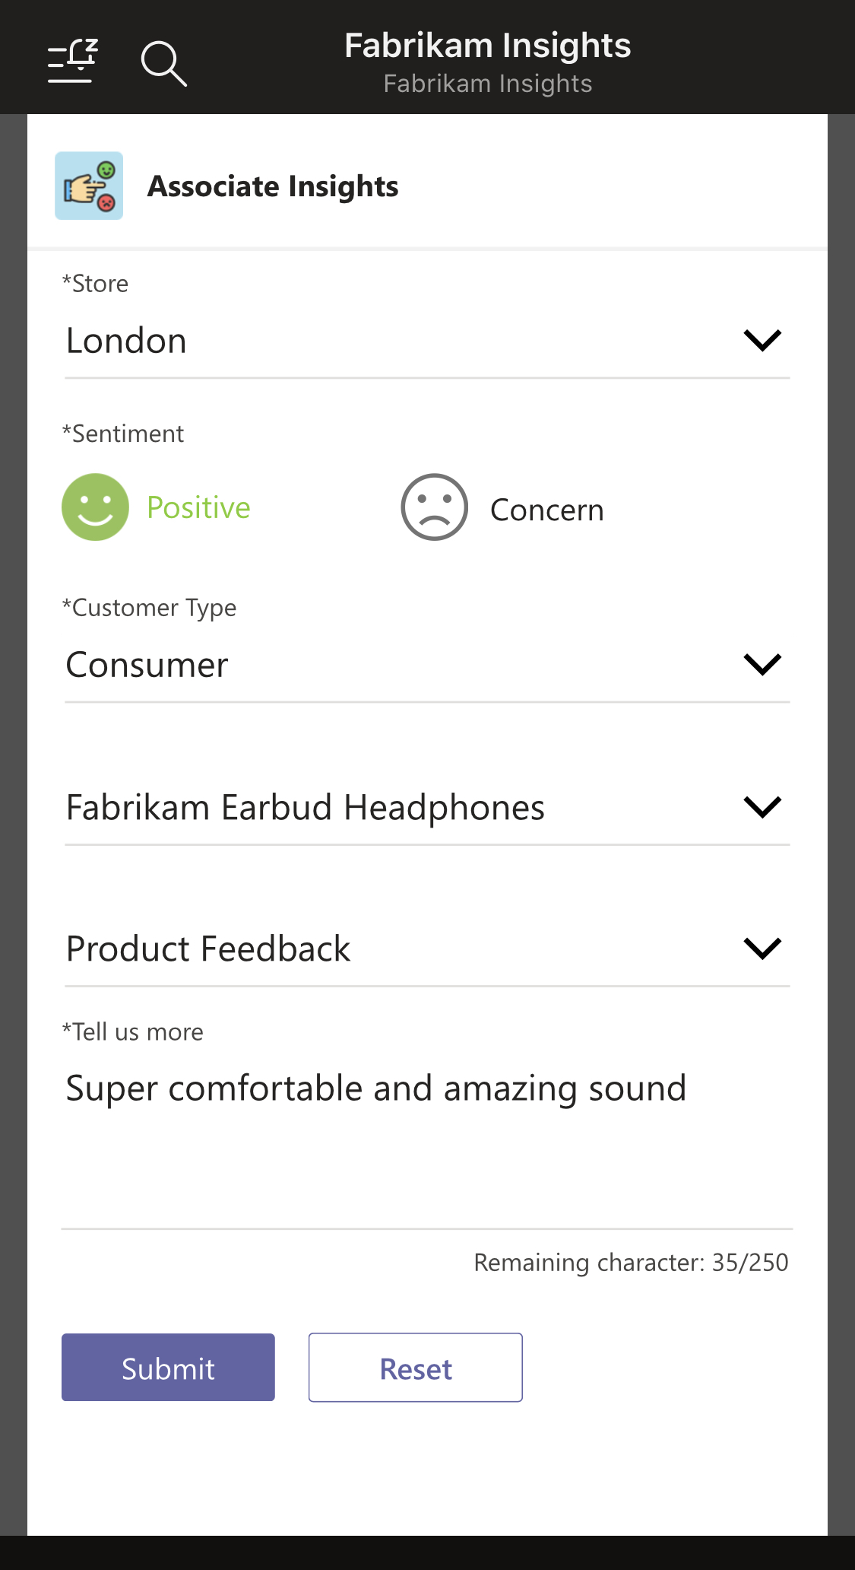
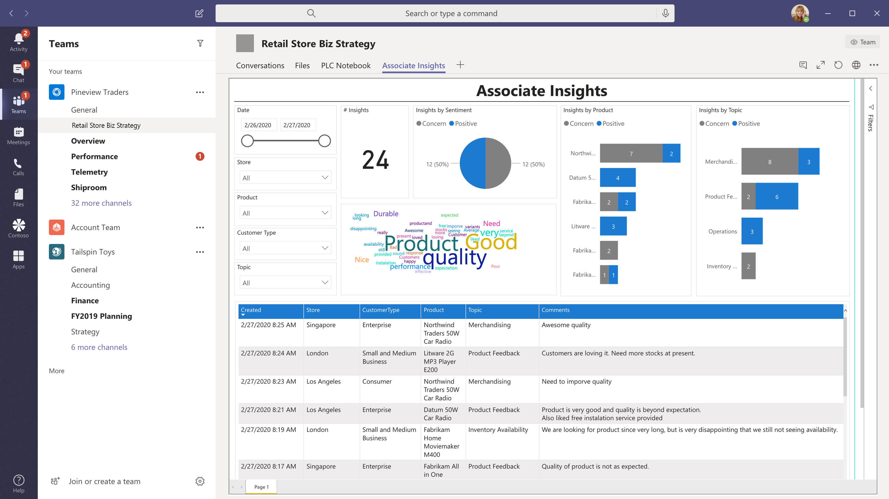
Capture feedback
Notes:
Capture feedback and understand where you can improve

Slide 12




M365 framework
a
b
c
d
e
Fluent UI, Graph Toolkit, Adaptive Cards
a
Microsoft Graph
b
Community
Notes:
What’s available today
Build on any OS/platform
SDKs
Tooling
Microsoft
Community
Extend Teams, SharePoint and Office
Common UI language
Powered by Graph
SDKs
Graph Toolkit
Supported by community

Slide 13



The easiest way to get started building apps for Microsoft Teams Teams Toolkit Preview
Project Generator Tabs, Bots, Message Extensions, Samples | 🗸
F5 & Debugging | 🗸
Identity | Single-Line Auth
Front-end Hosting | 🗸
Integrated Azure Functions | 🗸
Microsoft Graph | Single-Line Graph
Azure SQL | 🗸
SPFx integration | 🗸
Deployment Automation | 🗸
Bicep Templates | 🗸
Publishing | 🗸
Extensibility | 🗸
CLI | 🗸
Blazor Support | 🗸
Automatic Tunneling | 🗸

Slide 14
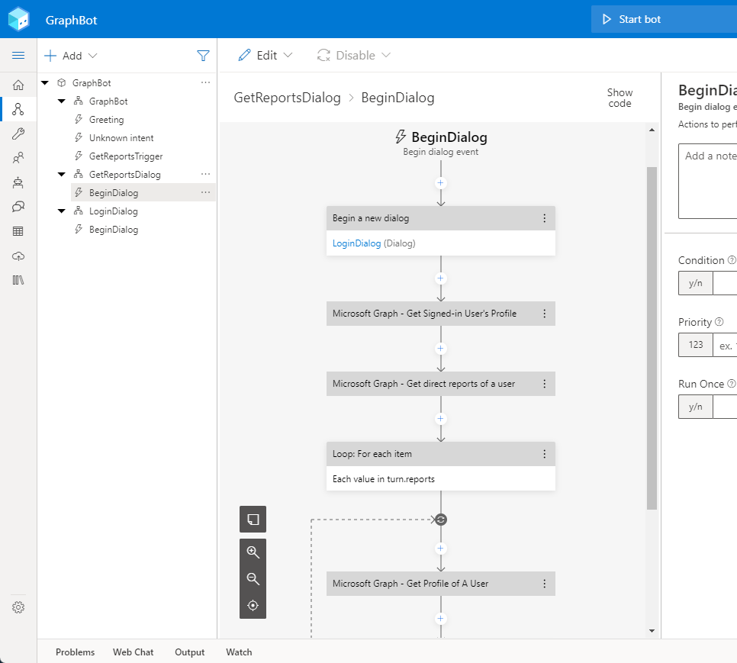
Demo Build a Blazor Teams Tab & Build a Composer Bot all powered by the Graph

Slide 15

Client-side Blazor runs client-side on WebAssembly
Server-side Blazor runs on the server via SignalR
https://aka.ms/awesomeblazor

Slide 16
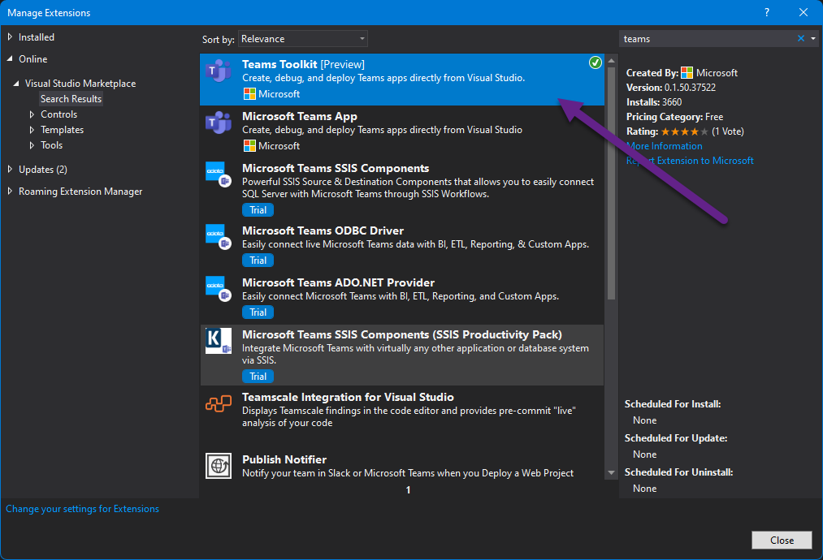
Microsoft Teams Framework (TeamsFx) [IN PREVIEW!]
Microsoft Teams Framework is a library encapsulating common functionality and integration patterns (like simplified access to Microsoft Identity) for developers building apps for Microsoft Teams.
The Teams Developer Platform offers a collection of solutions for Teams developers:
IDE extensions for Visual Studio and Visual Studio Code named "Teams Toolkit"
Docs, samples
Code libraries including Teams Framework teamsfx and the Teams Client Library teams-js
A command line tool teamsfx for terminal users, automation, and CI

Slide 17
Learn
Reuse
Share
Microsoft 365 Patterns and Practices
Notes:
You’re not alone
Sample code, guidance and docs available for you to reuse
Community of like-minded people to help you out
Focus on your app and stay productive

Slide 18
Microsoft 365 Patterns and Practices (PnP)
>600 samples
>1,680
awarded
for helping to learn to extend Microsoft 365
Contributors in GitHub organizations
Internally at Microsoft as a reference model for community engagement
aka.ms/m365pnp
>73,000
>63,000
>3.4 million
Visitors in GitHub organizations in past 2 weeks
Tenants using open-source components each month
Watch time minutes in the YouTube channel within last 365 days

Slide 19
Next steps
See examples of extending Microsoft Teams aka.ms/templates-teams
Try Teams Toolkit aka.ms/teams-toolkit
Learn more about building for Microsoft Teams aka.ms/start-teams
Get started with Bot Framework Composer aka.ms/bfcomposer

Slide 20
What are you going to build?

